Slide 1
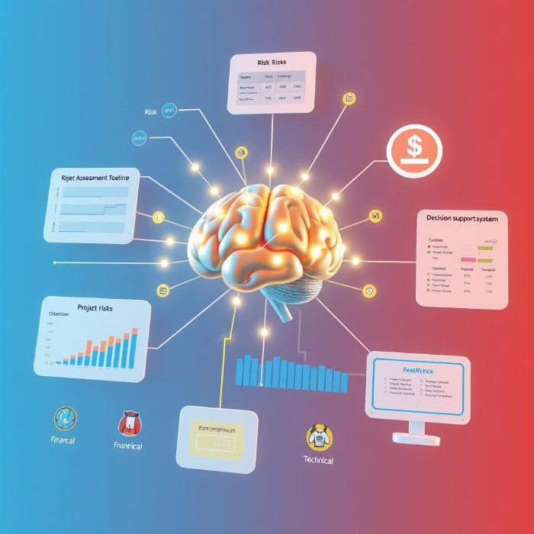
AI Enhanced Risk Management Steps for Building a New Student Management System

Slide 2
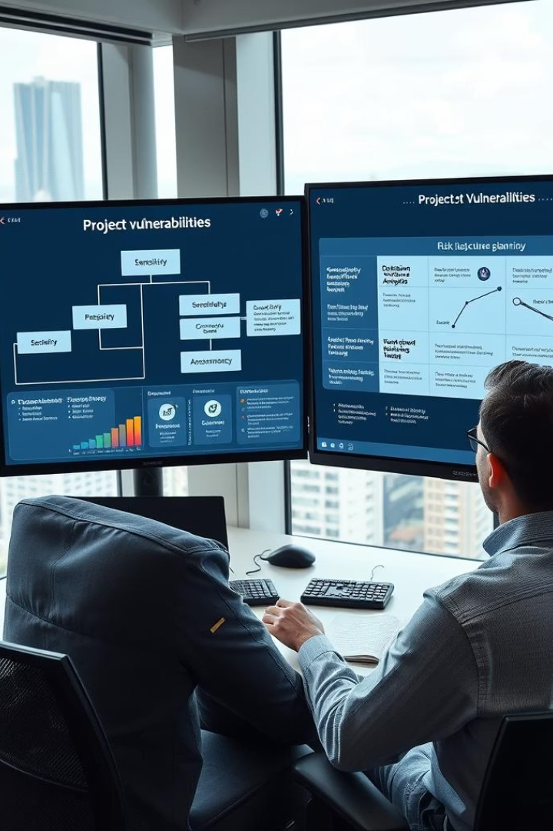
What is Risk Management in Project Management?
Risk management identifies, assesses, and controls threats to project success.
It helps teams minimize negative impacts on timelines, costs, and quality.
Proactive risk management ensures informed decision-making throughout the project lifecycle.

Slide 3

The 7 PMBOK Risk Management Processes
1
Plan Risk Management
Define how to approach and plan risk activities effectively.
2
Identify Risks
Recognize potential risks that could impact the project.
3
Perform Qualitative Risk Analysis
Assess risks based on their likelihood and impact.
4
Perform Quantitative Risk Analysis
Quantify risks using numerical methods for better precision.
5
Plan Risk Responses
Develop options to enhance opportunities and reduce threats.
6
Implement Risk Responses
Apply the planned risk response strategies during execution.
Monitor Risks
7
Track identified risks and discover new ones as project evolves.

Slide 4
TRADITIONAL APPROACH FOR PLANING RISK MANAGEMENT
Element
Details
Inputs
Project Charter, PM Plan, EEFs, OPAs
Tools & Techniques
Expert Judgment, Meetings
Outputs
Risk Management Plan

Slide 5
AI POWERED ENHANCEMENTS
Prompt Used :- You are an expert project risk manager. Create a comprehensive Risk Management Plan for a new university-level Student Management System (SMS) project. The system must support functionalities such as:
Student registration and course enrollment
Academic calendar integration
Grading and assessments
Personal student data storage (sensitive PII)
Admin and faculty access controls
Assume the project duration is 6 months and is handled by a university IT team. Highlight risks such as exam-week server load, FERPA compliance issues, grading errors, and user resistance.

Slide 6
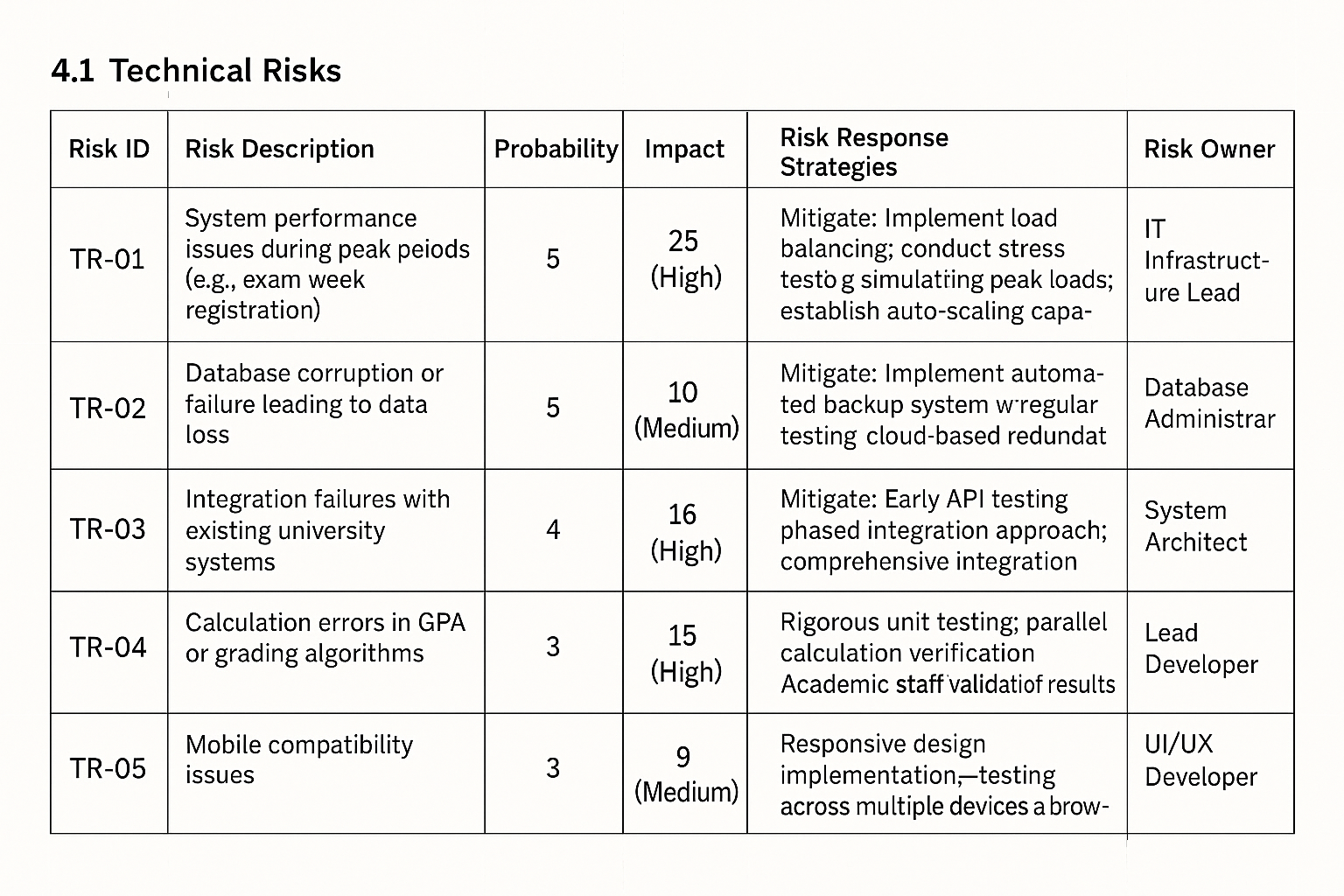
What CLAUDE gave us ?
Section
Claude's Generated Output
Risk Categories
Technical, Compliance, Schedule, Stakeholder
Roles & Responsibilities
Clear matrix for PM, QA, Security, etc.
Risk Matrix
Probability × Impact scale (1–5), response strategy matrix

Slide 7
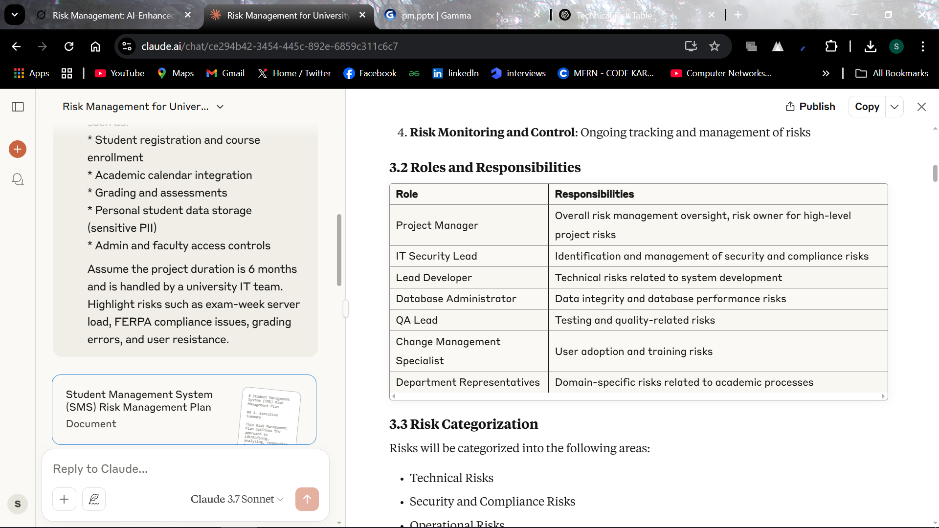
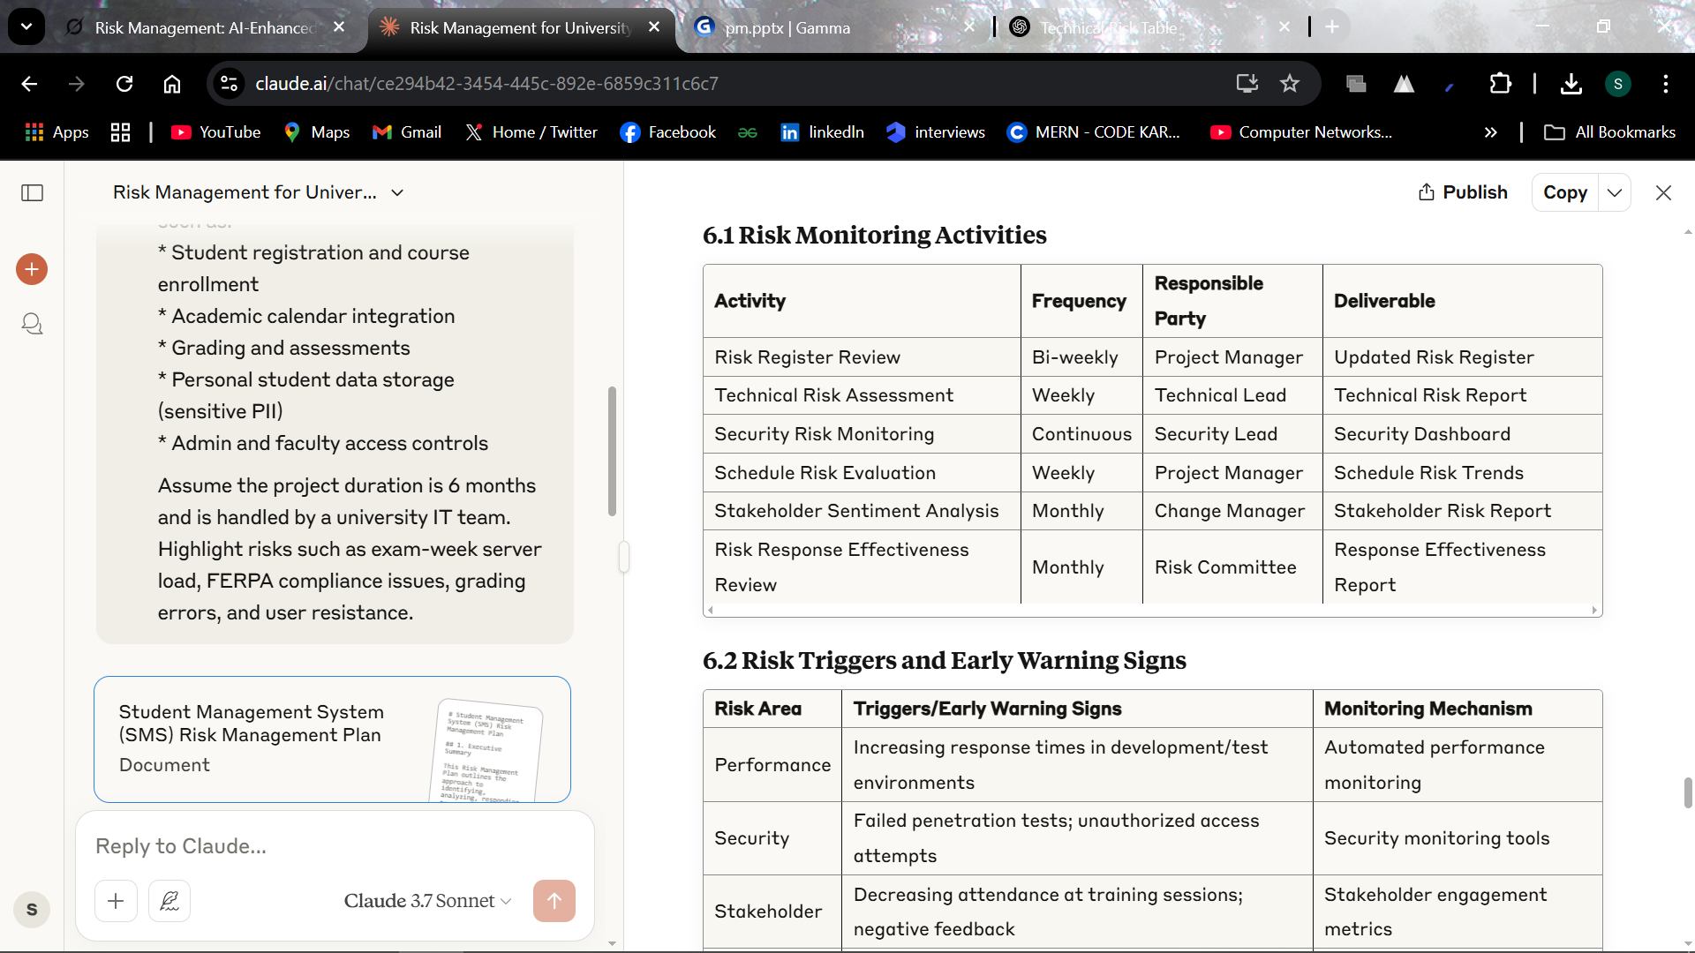
What CLAUDE gave us ?

Slide 8
TRADITIONAL APPROACH FOR IDENTIFYING RISKS
Element
Details
Inputs
Project Charter, Requirements Docs, Stakeholder Register, Assumption Log
Tools & Techniques
Expert Judgment, Brainstorming, Interviews, Checklists, SWOT Analysis
Outputs
Initial Risk Register, Risk Report (optional)

Slide 9
AI POWERED ENHANCEMENTS
Tool
Role
What It Does
AskYourPDF
Document Risk Extractor
Scans PDFs like risk plans or meeting transcripts, requirements Docs to extract and group project risks
ChatGPT
Risk Categorization Assistant
Generates and organizes risks into categories (Technical, Compliance, Stakeholder, etc.) based on project context
Prompt Used :-
You are a project risk analyst. Based on the implementation of a university-level Student Management System (SMS), list 10 realistic project risks grouped by category: Technical, Compliance, Stakeholder, Operational, and Schedule. For each risk, include a one-line description.
Refer to real-world risk examples or patterns found in case studies, research papers, or post-implementation reports of similar EdTech or SIS (Student Information System) projects where possible

Slide 10
AI POWERED ENHANCEMENTS
AskYourPDF Workflow :-
We uploaded the detailed Risk Management Plan generated by Claude.
Then, we asked AskYourPDF:
"Extract all risks mentioned in this document and group them by category."
In a real project, we would upload stakeholder meeting transcripts or requirement documents to AskYourPDF and use it to generate risk lists directly from what users or clients are saying.

Slide 11
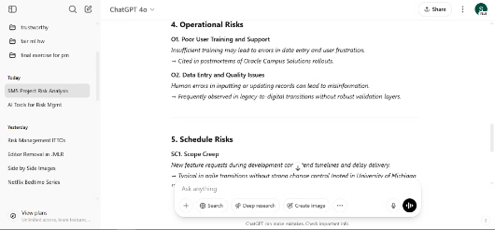
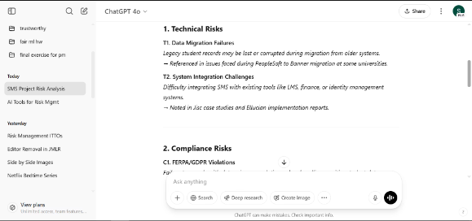
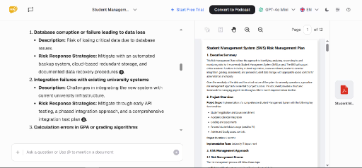
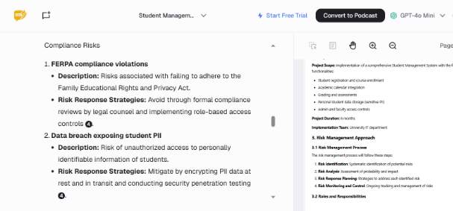
What Chatgpt & AskyourPDF gave us?

Slide 12
TRADITIONAL APPROACH FOR QUALITATIVE RISK ANALYSIS
Elements
Details
Inputs
Risk Register, Risk Management Plan, Project Documents (Stakeholder Register, Assumption Log), EEFs, OPAs
Tools & Techniques
Expert Judgment, Data Gathering (Interviews), Data Analysis (Risk Probability and Impact Assessment, Risk Categorization), Risk Data Quality Assessment, Interpersonal and Team Skills, Risk Categorization, Probability and Impact Matrix
Outputs
Project Documents Updates (Risk Register, Risk Repor

Slide 13
AI POWERED ENHANCEMENTS
Tool
Role
What It Does
Prompt Used
Power BI + Copilot
Risk Dashboarding Assistant
Visualizes and ranks risks using AI on historical project data and trends
"You are a data analyst for a Student Management System project. Create a Power BI dashboard description to rank risks like server overload, FERPA compliance, and scope creep by probability and impact. Include a probability-impact matrix and risk trend visualization."
Grok
Risk Scoring Engine
Classifies and auto-scores risks by probability and impact based on labeled text
"You are a risk analyst for a Student Management System project. Analyze risk descriptions (e.g., 'server overload during exam week,' 'FERPA non-compliance,' 'scope creep') and assign probability (Low/Medium/High) and impact (Low/Medium/High) scores. Output a categorized risk list."
Workflow:
Power BI + Copilot: Generates a dashboard with a probability-impact matrix and risk trends for the SMS project.
Grok: Processes risk descriptions to assign qualitative scores, updating the risk register.

Slide 14
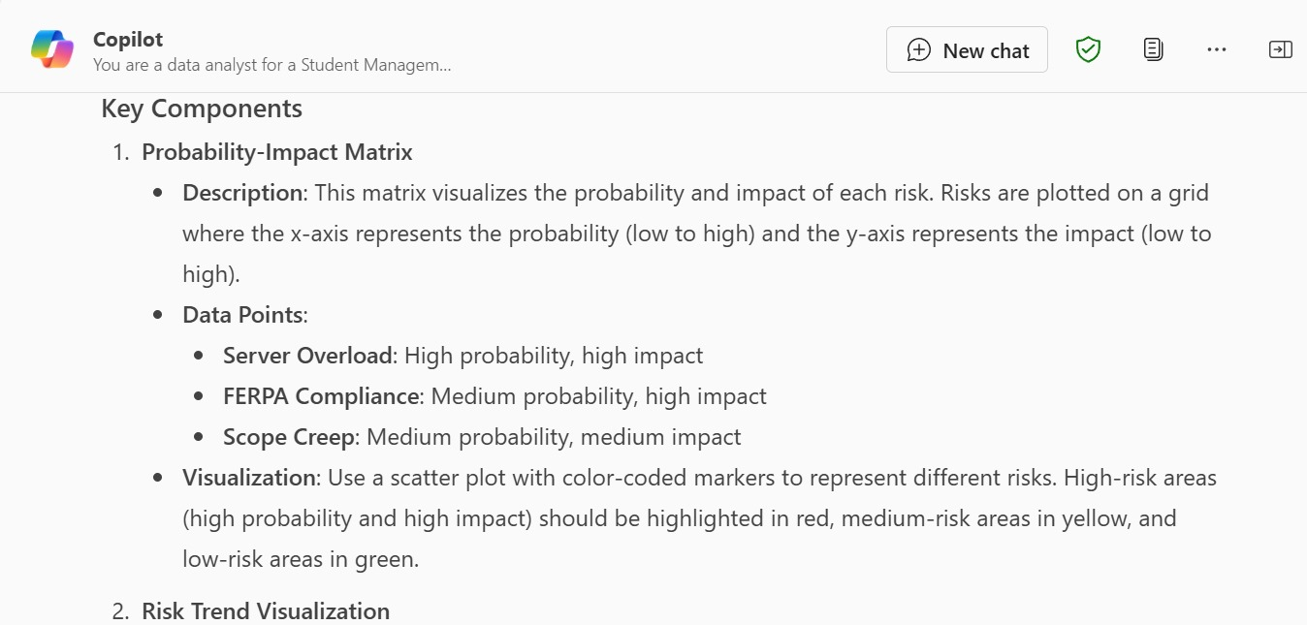
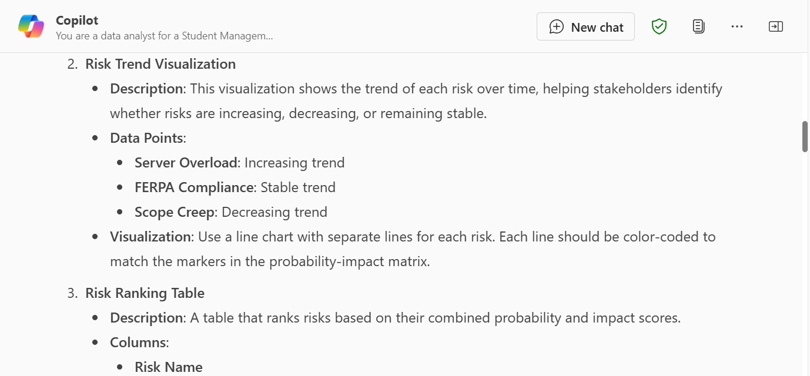
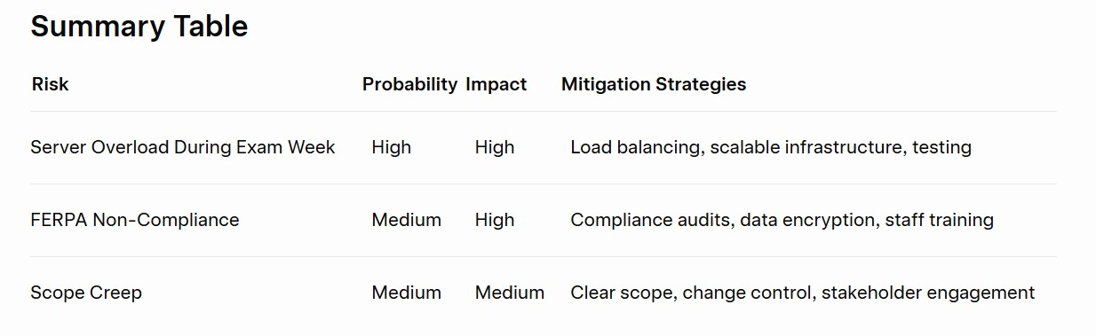
What Copilot & Grok gave us?

Slide 15
TRADITIONAL APPROACH FOR Quantitative Risk Analysis
Element
Details
Inputs
Risk Register, Risk Management Plan, Cost Baseline, Schedule Baseline, EEFs, OPAs
Tools & Techniques
Expert Judgment, Data Analysis (Simulation, Sensitivity Analysis, Decision Tree Analysis), Representation of Uncertainty
Outputs
Project Documents Updates (Risk Report, Probabilistic Analysis of the Project)

Slide 16
AI POWERED ENHANCEMENTS
Tool
Role
What It Does
Monte Carlo Simulation with Python + ChatGPT
Probabilistic Risk Modeler
Generates probabilistic cost and schedule outcomes using Monte Carlo simulations for SMS risks
Prompt Used :- "You are a data scientist specializing in project risk management. Write a Python script using NumPy to run a Monte Carlo simulation for a 6-month Student Management System project. Assume risks like server downtime (10-20% probability, 2-5 day delay), data migration failure (15% probability, $10k-$20k cost overrun), and scope creep (30% probability, 10-15 day delay). Output probabilistic completion time and cost estimates."
Work Flow :-
ChatGPT: Generates a Python script for Monte Carlo simulation, incorporating risk probabilities and impacts specific to the SMS project.

Slide 17
AI POWERED ENHANCEMENTS
Tool
Role
What It Does
Gemini
Sensitivity Analysis Assistant
Identifies which risks (e.g., FERPA compliance, server load) have the highest impact on project cost/schedule
Prompt Used :- Analyze the sensitivity of a Student Management System project to the following risks: server overload during exam week, FERPA compliance issues, and scope creep. Rank them by impact on a 6-month timeline and $200k budget. Provide a tornado diagram description.
Workflow :-
Gemini: Processes risk data to produce a sensitivity analysis, highlighting critical risks via a tornado diagram.

Slide 18
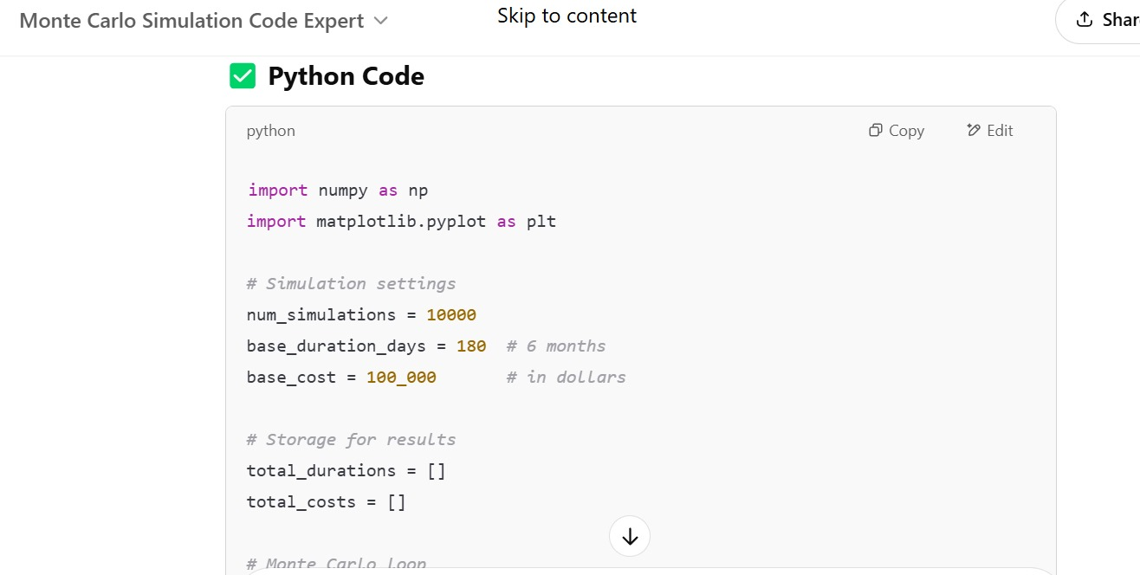
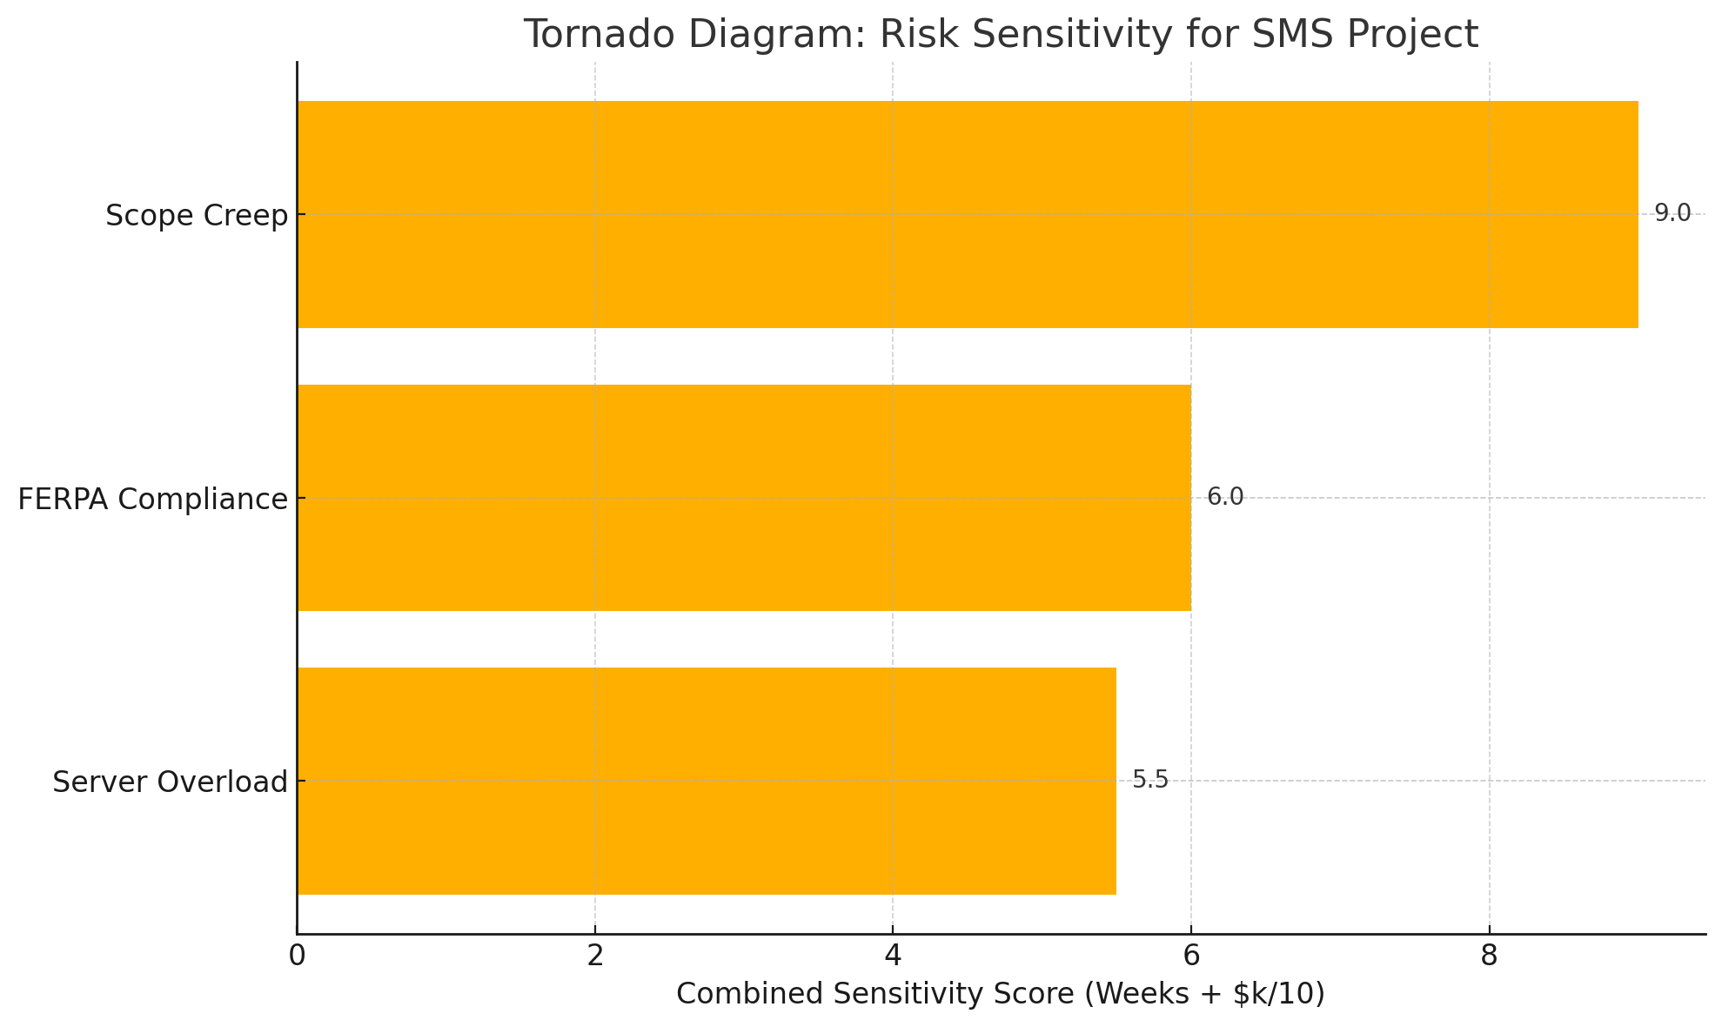
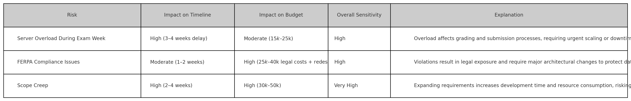
What Chatgpt & Gemini gave us?

Slide 19
TRADITIONAL APPROACH FOR Plan Risk Response
Element
Details
Inputs
Risk Register, Risk Management Plan, Project Management Plan, EEFs, OPAs
Tools & Techniques
Expert Judgment, Strategies for Threats (Avoid, Transfer, Mitigate, Accept), Strategies for Opportunities, Contingent Response Strategies
Outputs
Project Management Plan Updates, Project Documents Updates (Risk Register, Risk Report)

Slide 20
AI POWERED ENHANCEMENTS
Tool
Role
What It Does
Prompt Used
Claude
Risk Response Strategist
Suggests tailored response strategies for SMS risks, including mitigation and contingency plans
"You are a project risk manager for a Student Management System project. For risks like server overload, FERPA non-compliance, and scope creep, propose specific response strategies (Avoid, Mitigate, Transfer, Accept). Include one contingency plan per risk. Project duration: 6 months, handled by university IT."
GitHub Copilot
Response Plan Drafter
Assists in drafting detailed mitigation plans, including resource allocation and timelines
"Write a mitigation plan in Markdown for addressing server overload risk in a Student Management System project. Include actions, responsible roles, and a timeline for implementation."
Workflow:
Claude: Generates a comprehensive list of response strategies, covering threats and opportunities for SMS risks.
GitHub Copilot: Produces detailed mitigation plans in a structured format, ready for inclusion in the project management plan.

Slide 21
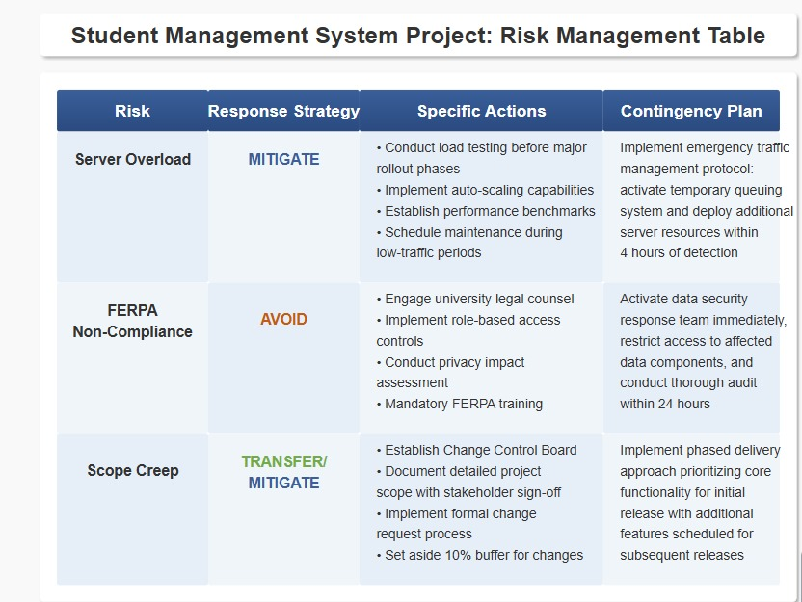
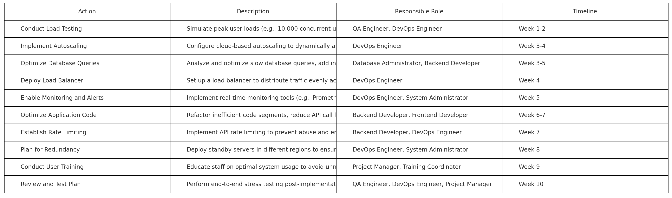
What Claude & Github Copilot gave us?

Slide 22
Implement Risk Responses - Traditional Approach
Elements
Details
Inputs
Risk Register, Risk Management Plan, Lessons Learned Register, EEFs, OPAs
Tools & Techniques
Expert Judgment, Project Management Information System, Interpersonal and Team Skills
Outputs
Change Requests, Project Documents Updates (Risk Register, Issue Log)

Slide 23
AI POWERED ENHANCEMENTS
Tool
Role
What It Does
Prompt Used
ChatGPT
Action Plan Coordinator
Generates detailed action plans and communication templates for executing risk responses
"You are a project coordinator for a new Student Management System project. Create a detailed action plan for implementing a server overload mitigation strategy (cloud server upgrade). Include steps, responsible parties, deadlines, and a stakeholder communication email template."
Notion AI
Progress Tracker
Tracks implementation progress and flags delays in risk response actions
"Track the progress of a server overload mitigation plan for a Student Management System project. List tasks (e.g., vendor selection, server testing), assign roles, set deadlines, and flag any tasks at risk of delay."
Workflow :-
ChatGPT: Produces a step-by-step action plan and a professional email template for stakeholder updates.
Notion AI: Organizes tasks in a trackable format, providing automated reminders and delay alerts.

Slide 24
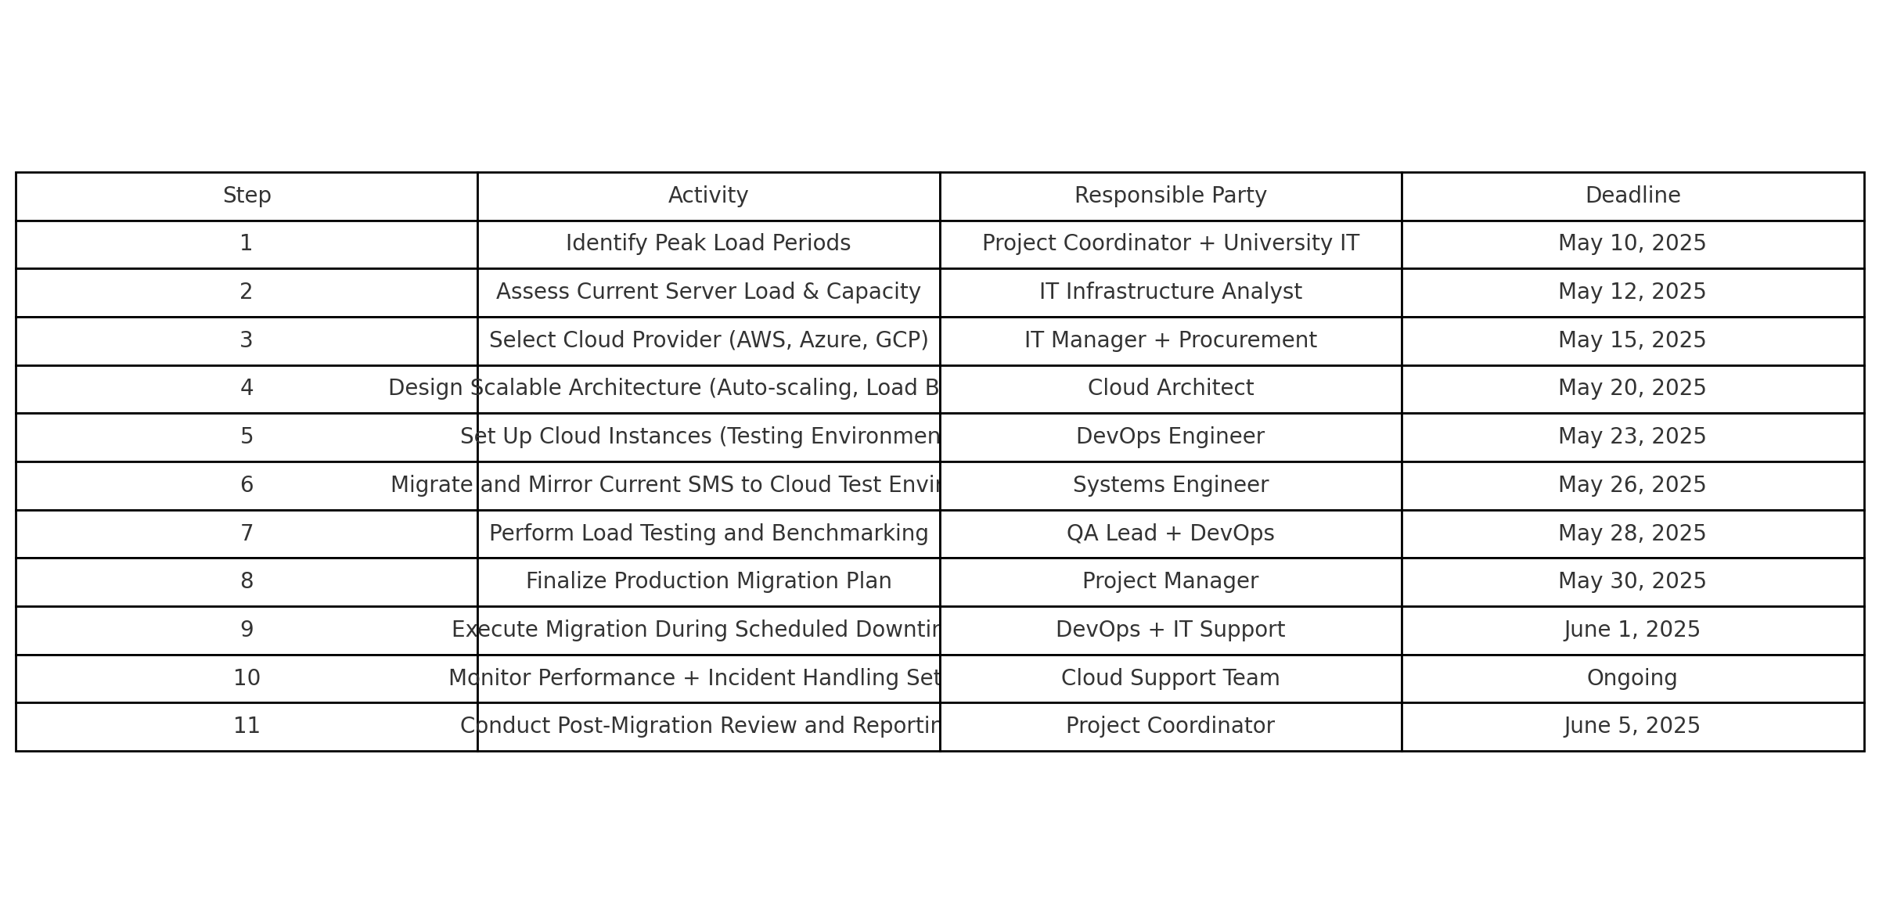
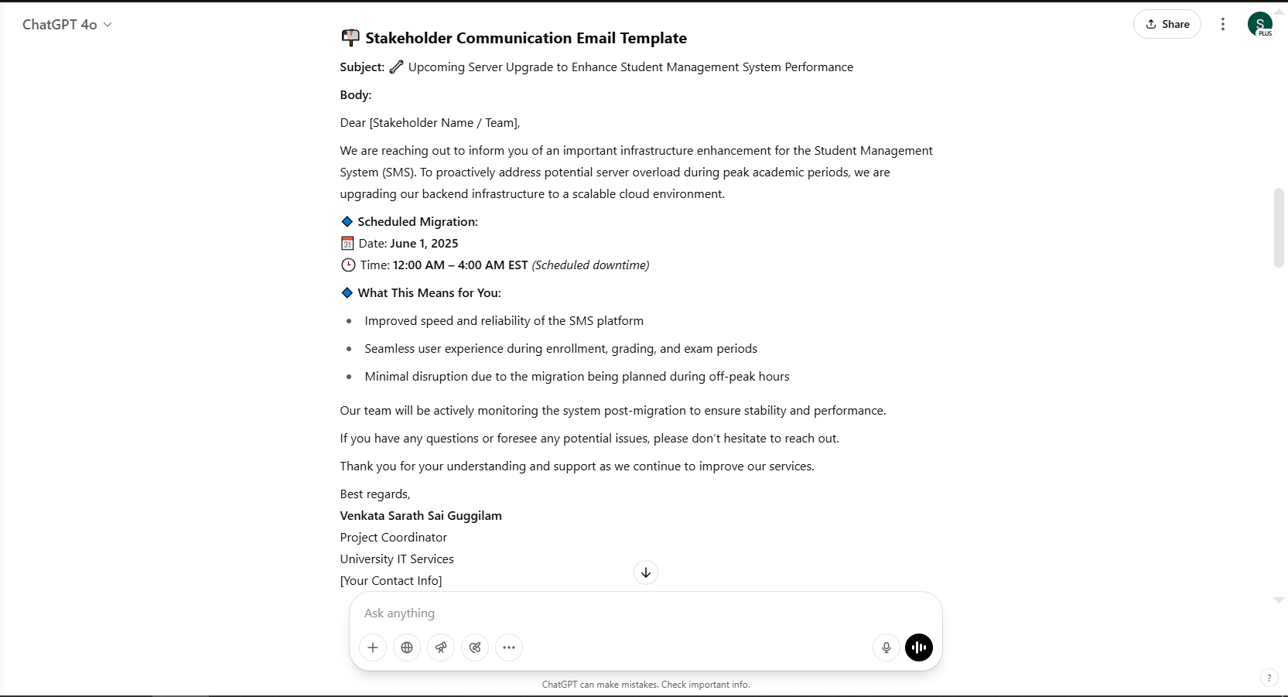
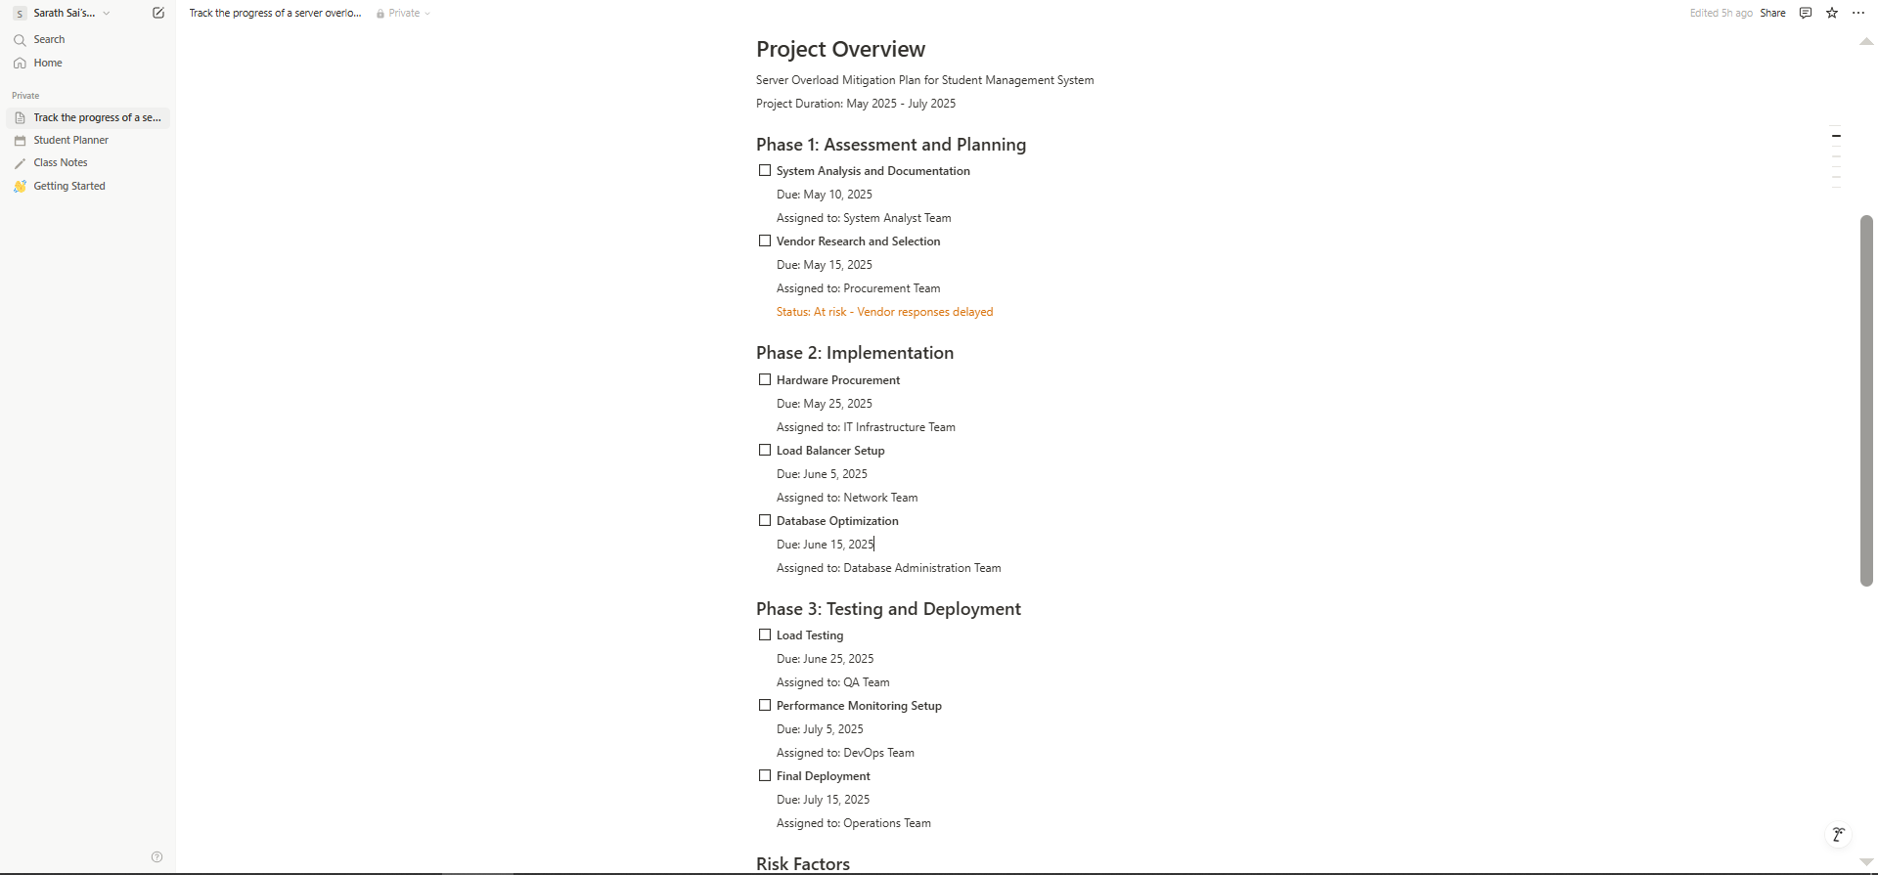
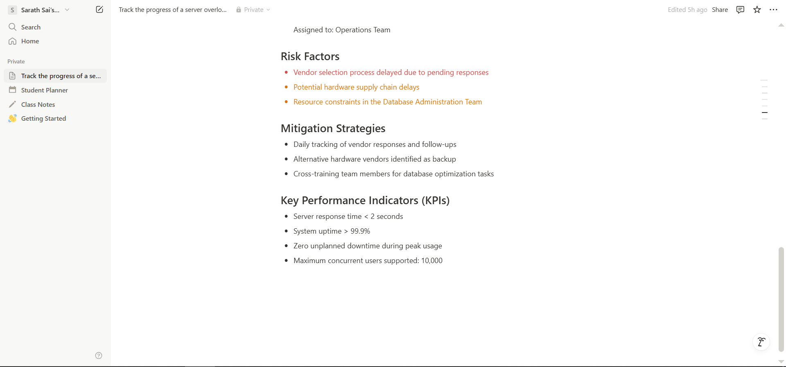
What Chatgpt & Notion AI gave us

Slide 25
Monitor Risks - Traditional Approach
Elements
Details
Inputs
Risk Register, Risk Management Plan, Work Performance Data, Work Performance Reports
Tools & Techniques
Data Analysis (Risk Audits, Variance and Trend Analysis), Meetings
Outputs
Work Performance Information, Change Requests, Project Documents Updates (Risk Register, Risk Report)

Slide 26
AI POWERED ENHANCEMENTS
Tool
Role
What It Does
Prompt Used
Claude
Risk Audit Assistant
Generates risk audit reports and suggests updates to risk register based on project performance
"You are a risk auditor for a new Student Management System project. Based on performance data showing a 5-day delay and 10% budget overrun, generate a risk audit report. Identify triggered risks (e.g., scope creep), recommend risk register updates, and suggest corrective actions."
Workflow:
Claude: Produces a detailed audit report, updating the risk register with triggered risks and new mitigation strategies.

Slide 27
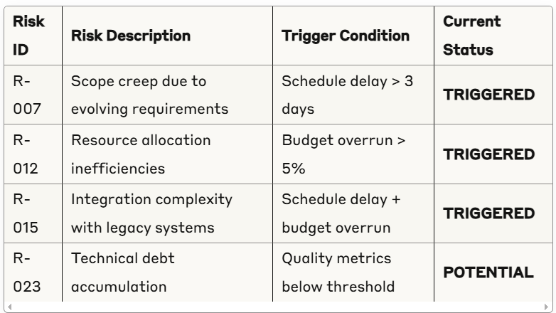
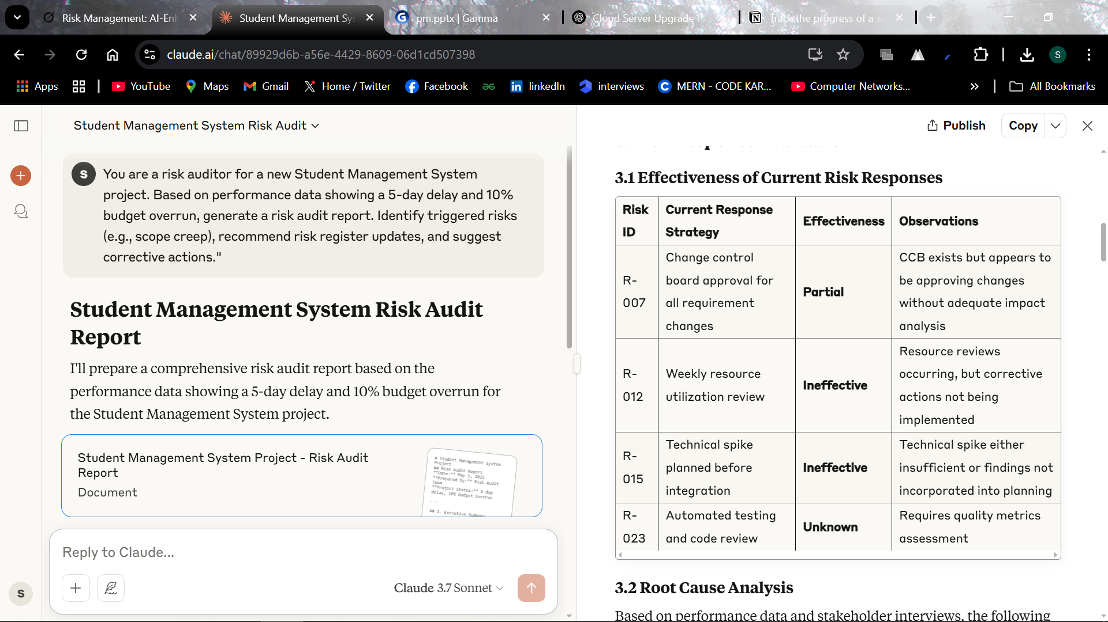
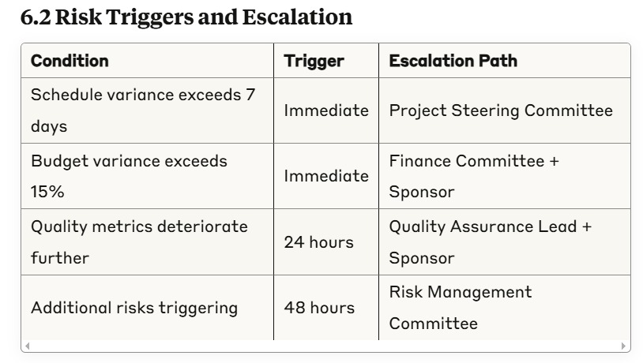
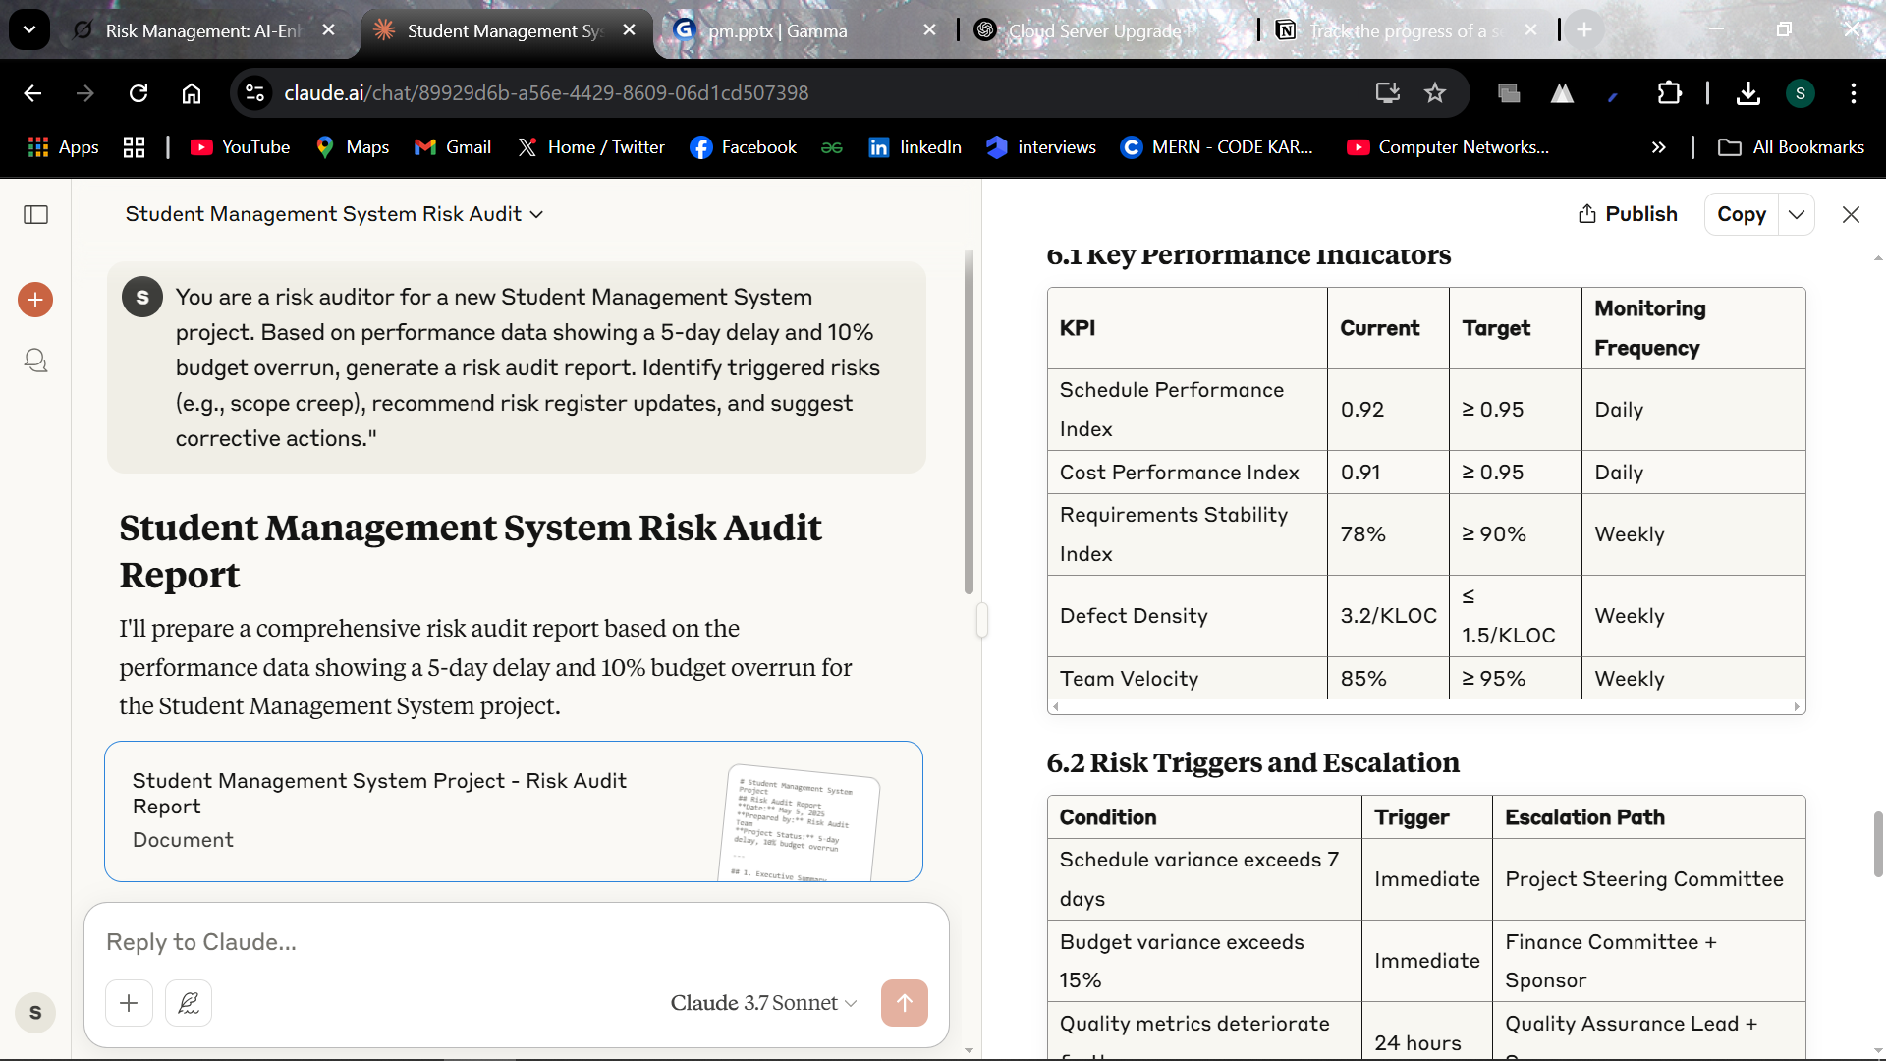
What Claude gave us

Slide 28



AI Enhanced Risk Management Workflow
Step 1: Plan Risk Management
1
Use ChatGPT or Claude to create a Risk Management Plan for the 6-month SMS project.
Step 2: Identify Risks
Use AskYourPDF and ChatGPT to extract and categorize risks from project documents.
Step 3: Perform Qualitative Risk Analysis
3
Score and visualize risks with Grok and Power BI heat maps.
Step 4: Perform Quantitative Risk Analysis
Simulate SMS project risks like server load or data breach using ChatGPT and Python Monte Carlo & Gemini.
Step 5: Plan Risk Responses
5
Suggest mitigation and contingency strategies with Claude and GitHub Copilot.
6
Step 6: Implement Risk Responses
Generate task plans and communications using ChatGPT and Notion AI.
Step 7: Monitor Risks
7
Build a live risk dashboard and generate audit reports with Claude.

Slide 29
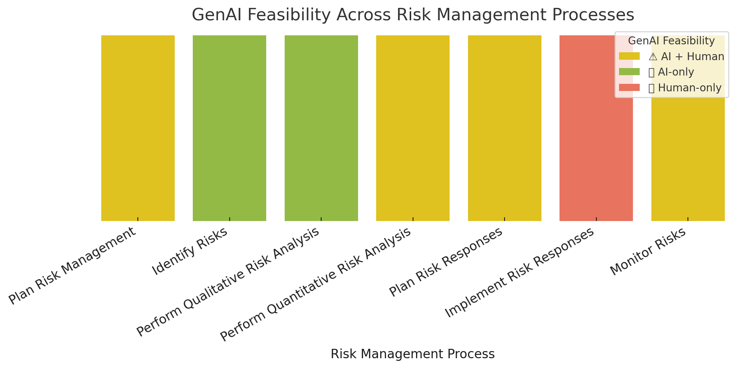
AI Automation Feasbility in Risk Management Processes

Slide 30
AI Challenges in Risk Management
Context Sensitivity: AI misses unique institutional policies and stakeholder nuances.
Input Quality: Structured, clear data is essential for accurate AI outputs.
Human Oversight: Experts must validate AI-generated risk plans and simulations.
Technical Expertise: Interpreting AI analysis like simulations demands skilled knowledge.
Emotional Intelligence: AI lacks insight into political, cultural, and behavioral risks.

Slide 31




Key Takeaways – AI’s Impact on Risk Management for SMS
Enhanced Efficiency:
Streamlined Tasks:
Human Judgment Essential:
Proactive Risk Handling:
GenAI tools accelerated all 7 risk management processes significantly.
Brainstorming, simulations, and register updates became near-instantaneous.
AI supports but does not replace context-sensitive decisions.
AI enabled faster, clearer anticipation and response to risks.

Slide 32
Thank You!

